Slide 1
GREEN AND SUSTAINABLE INTEGRATED WITH IOT IN AUTOMATIOMN
GREEN AND SUSTAINABLE INTEGRATED WITH IOT IN AUTOMATIOMN
By:
L.Sanjayan

Slide 2

Aerial Road Surface Inspection
Why This Project?
Poorly maintained roads affect safety and vehicle performance.
Manual pothole inspection is inefficient, costly, and prone to human error.
During monsoon seasons, hidden potholes lead to skids, accidents, and infrastructure degradation.
No system exists that performs real-time aerial mapping and severity-level detection.
Current drones are limited by short battery life and payload capacity.

Slide 3
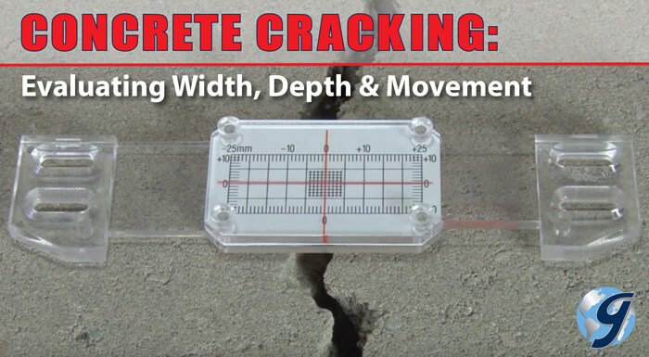
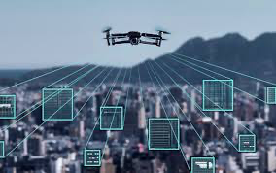
Cost-Effective & Effective Monitoring
Reduces manpower costs by automating road inspection tasks → No need for large teams walking or driving around for manual pothole checks.
Hybrid propulsion (Battery + HAN fuel) allows longer flights → Fewer flights = less recharging = less maintenance = more coverage per day.

Slide 4
The Bottlenecks in Road Safety Management
1. Limited Coverage & Inconsistent Inspections
The Problem:
Traditional road inspections depend on manual surveys, where workers drive or walk to visually inspect damaged areas.
This method is slow, inconsistent, and heavily affected by human fatigue, visibility conditions, and traffic.
Rural roads, narrow streets, and secondary roads often receive less attention, allowing potholes to grow unnoticed.
2. Short Battery Life of Conventional Drones
The Problem:
Commercial drones typically use electric battery power, giving only 15–30 minutes of flight time under payload.
With sensors, AI modules, or thermal cameras onboard, flight time drops further.
This limits the area a drone can monitor per mission, requiring multiple recharges or redundant drones.

Slide 5
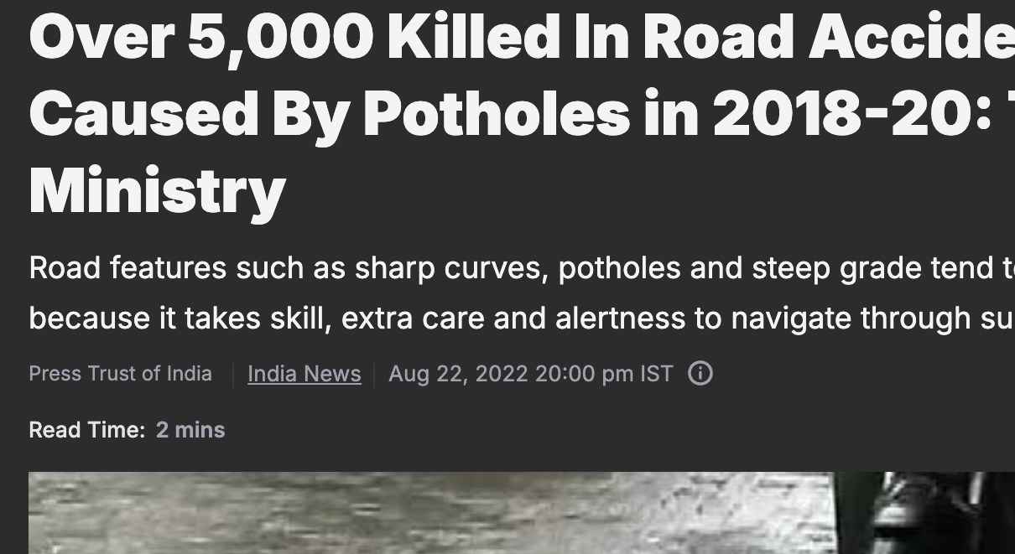
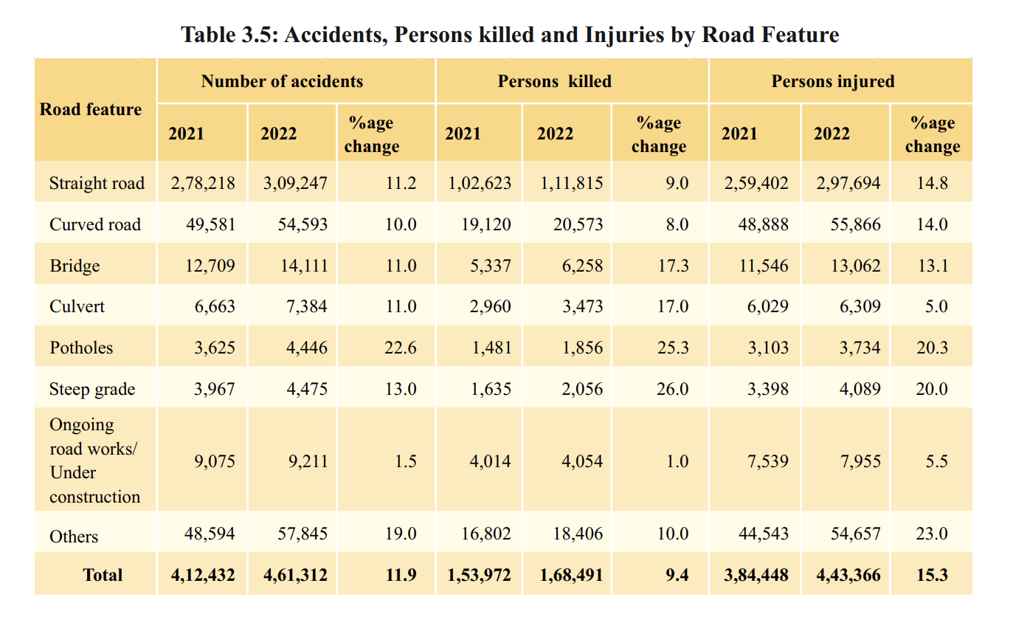
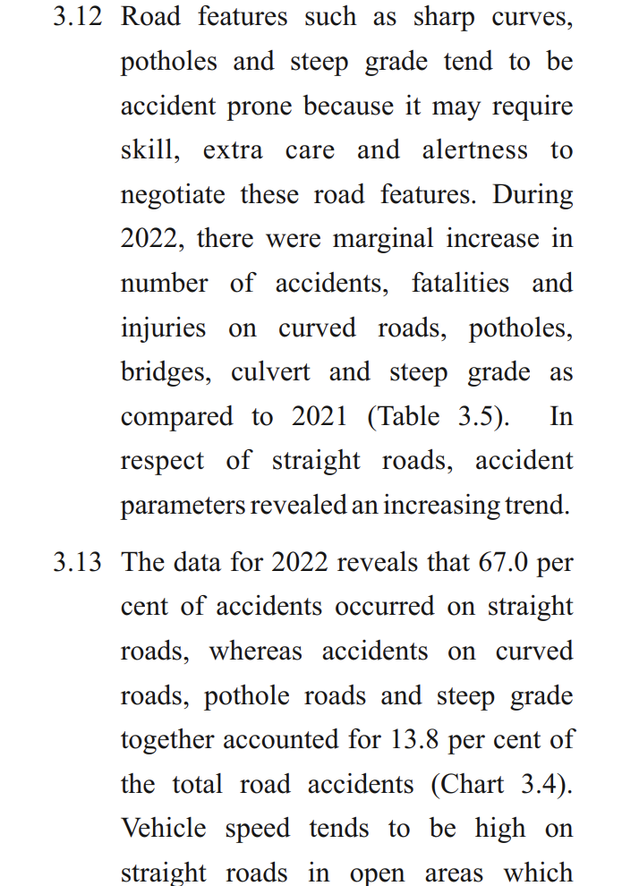
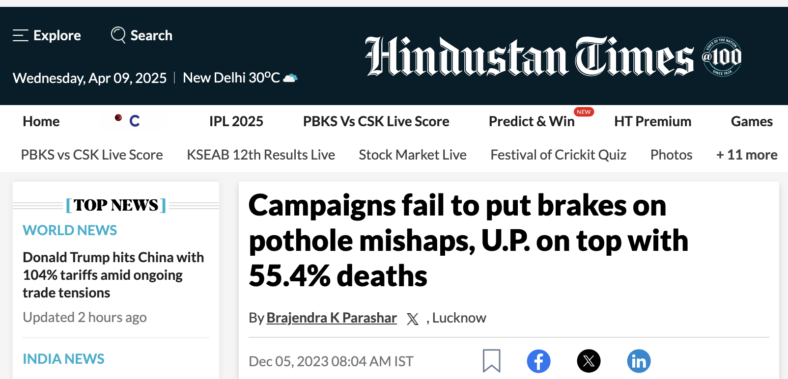

Slide 6
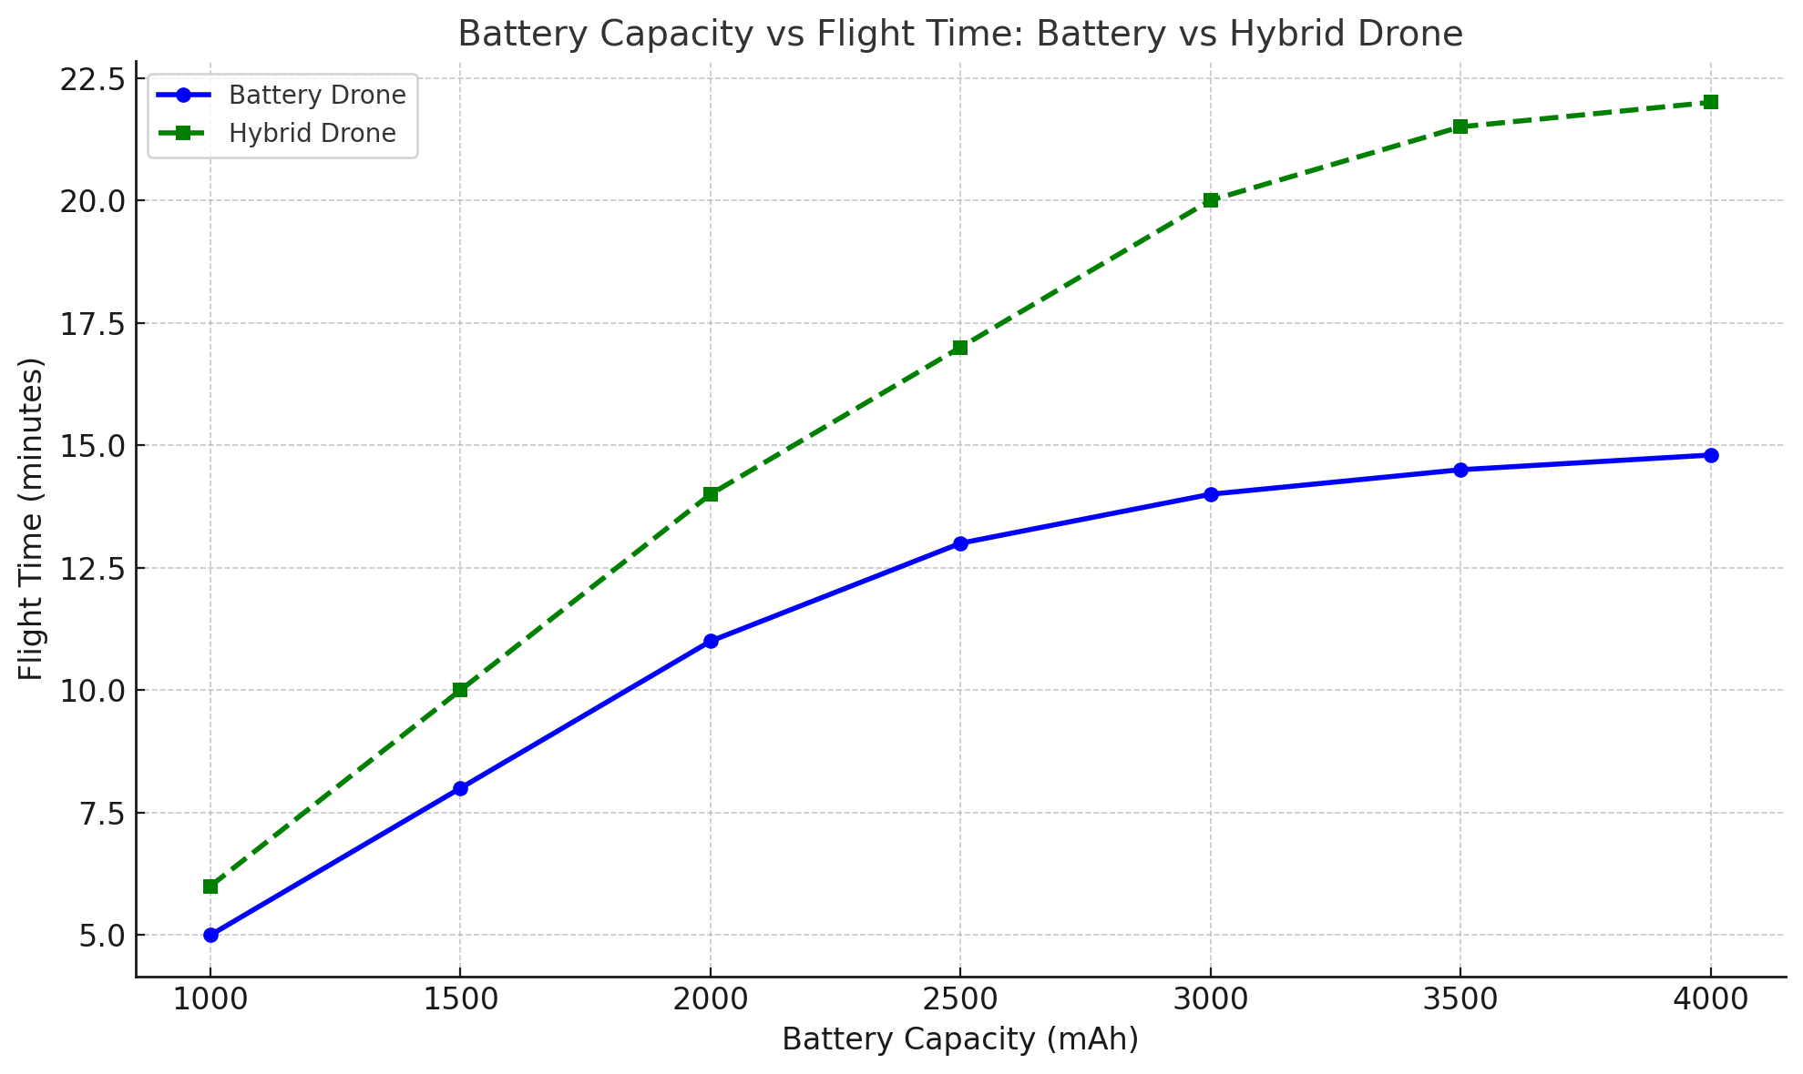
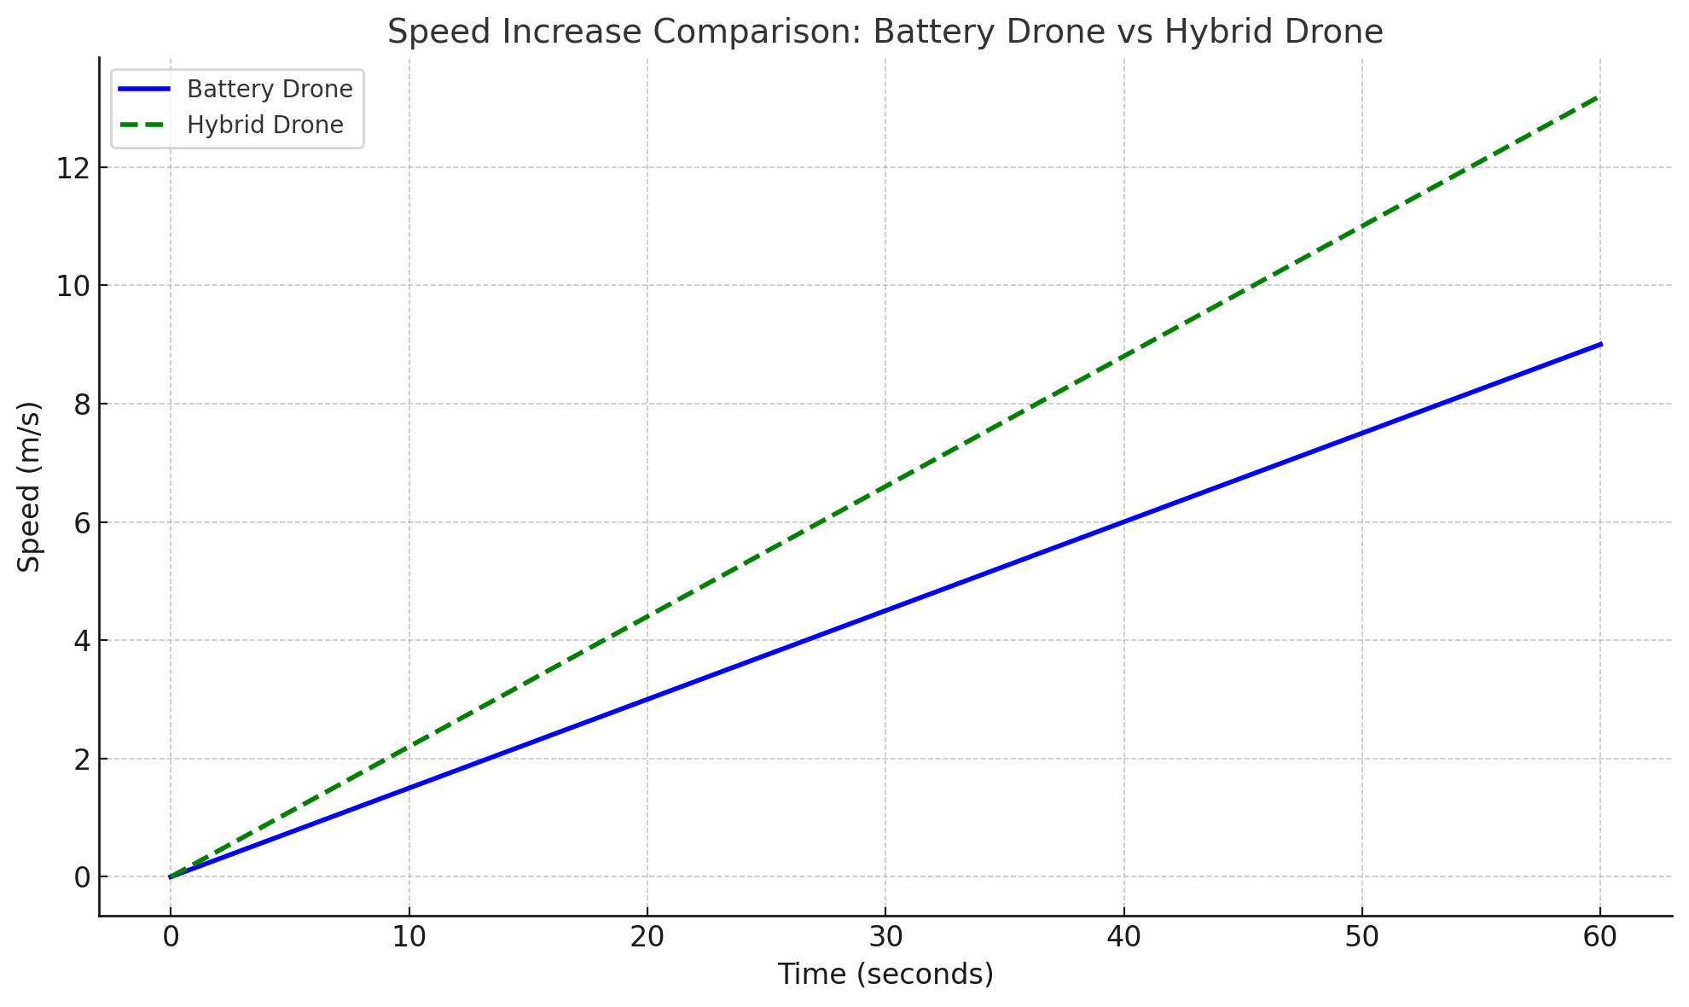
A battery-powered drone — slower, linear acceleration due to motor limits
A hybrid drone (battery + HAN fuel) — faster acceleration due to added thrust
Battery Drone: Gains in flight time slow down as capacity increases (due to added weight and motor limits).
Hybrid Drone: Maintains better scaling because fuel propulsion offsets battery strain, allowing longer, more efficient flights.

Slide 7
Key Components of the Solution:
High-Resolution Camera Module Mounted on the drone to continuously capture real-time road surface imagery.
AI-Based Detection Algorithm Utilizes deep learning (YOLO/CNN) models to detect potholes with high precision and classify them into severity levels:
Minor
Moderate
Severe
Severity Estimation Module Estimates pothole size and depth using image processing and area calculations to assist in repair prioritization.
Geo-Tagging System Integrates GPS data to tag the exact coordinates of detected potholes for mapping and reporting.

Slide 8



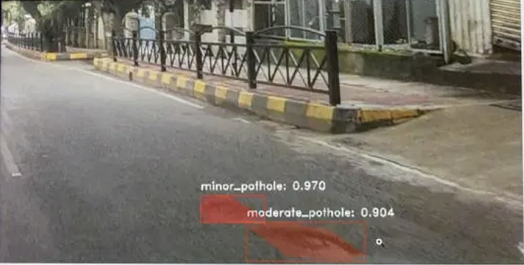
code

Slide 9
Solution Overview – Hybrid Drone Propulsion System
Battery-Electric Propulsion (Primary): Efficient, quiet electric motors for stable hovering, scanning, and low-speed cruise.
Green Fuel-Based Booster (Secondary): A propulsion unit based on hydroxylammonium nitrate (HAN) or NH₂OH + NO₃⁻, providing extra thrust for:
Heavy payload lift
Fast travel between scan zones
Emergency vertical takeoff or power boost
Flight Controller Integration: A microcontroller intelligently switches between power sources and balances usage for:
Thrust control
Stability
Efficiency
Payload Optimization: The drone is equipped to carry high-resolution cameras, thermal sensors, and onboard AI without sacrificing flight time.
Aerodynamic Design: Airframe uses a blended wing-body shape for:
Better lift-to-drag ratio
Internal fuel tank space
Passive stability in forward flight

Slide 10
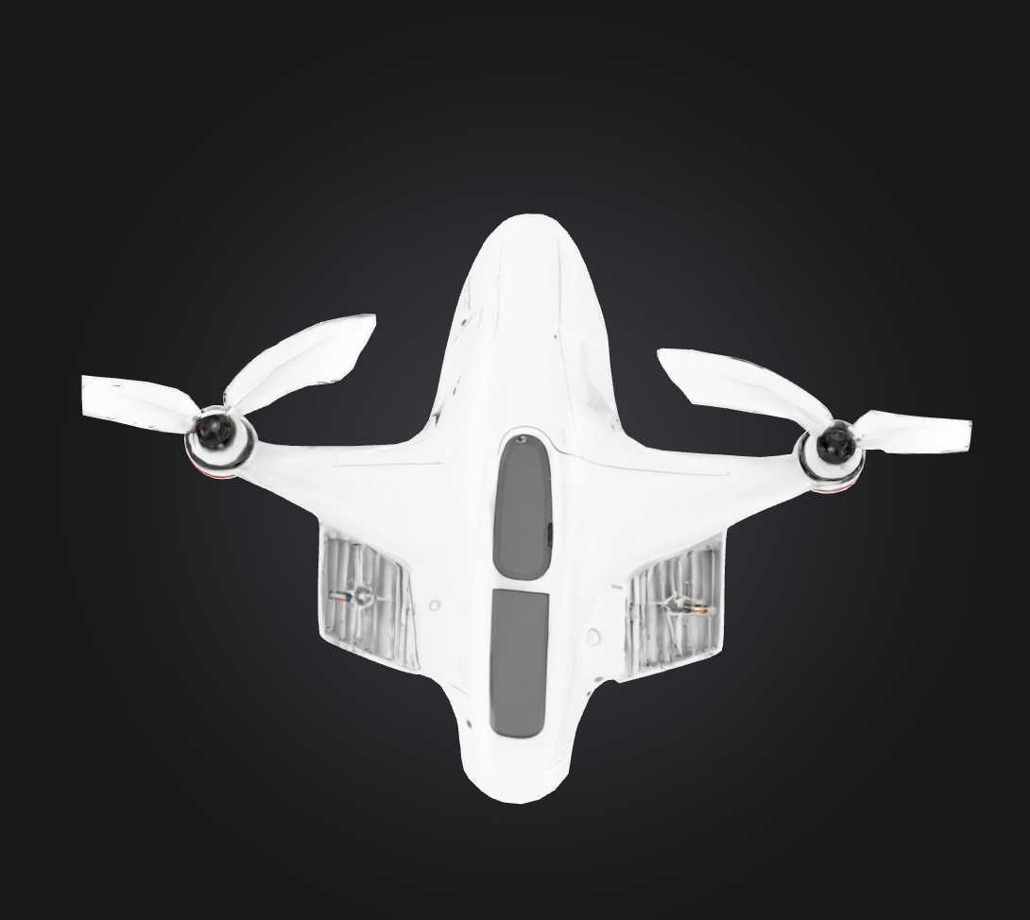
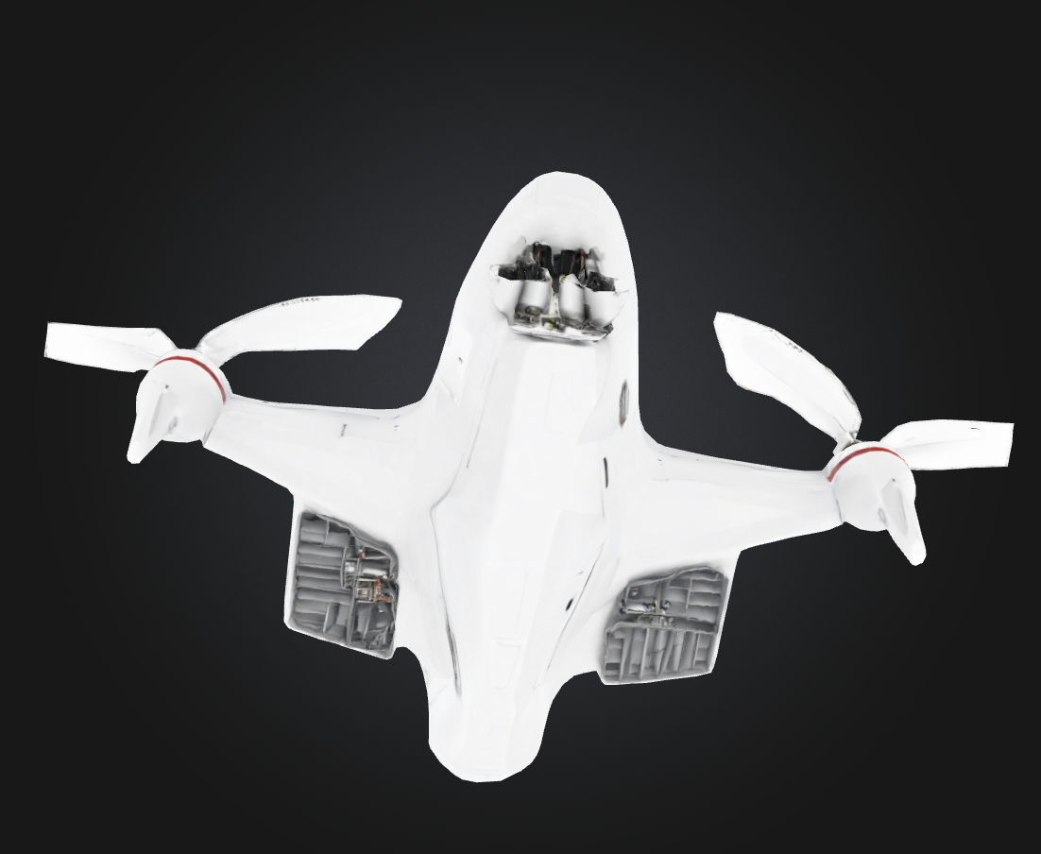
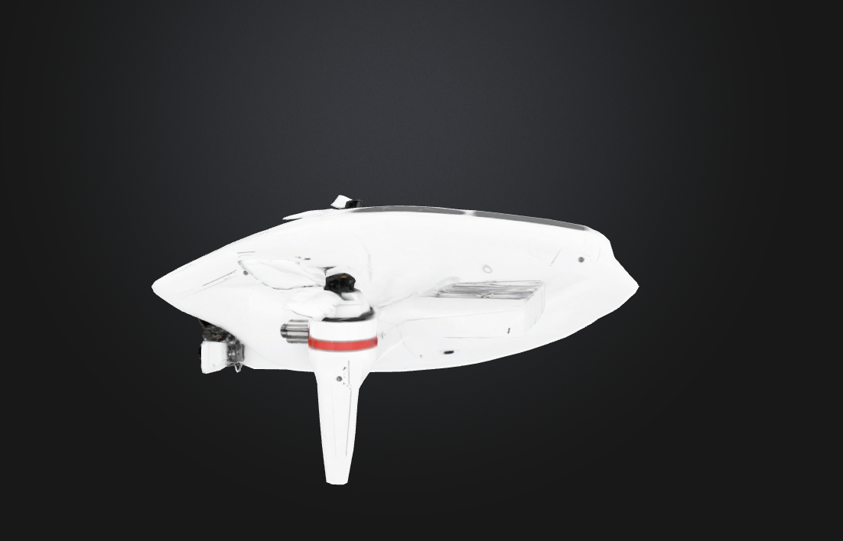
TOP VIEW
BOTTOM VIEW
SIDE VIEW

Slide 11
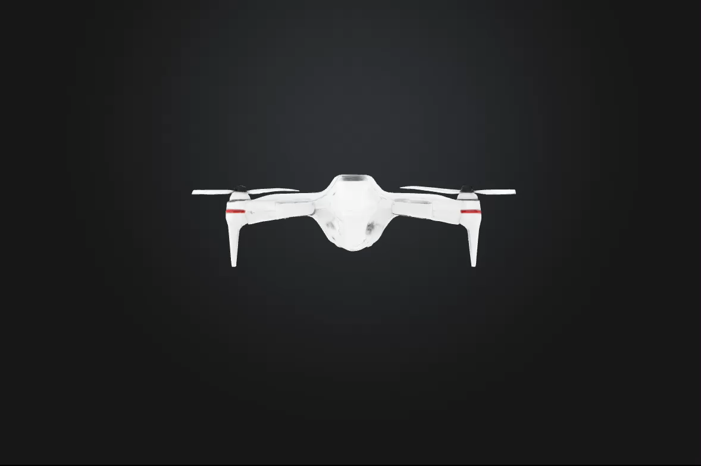

Slide 12
Aerodynamic Design and Shape of the Drone
1. Shape:
The drone has a blended-wing body or lift-body fuselage design with forward-swept wings and tilted rotors
This shape is chosen for the following reasons:
Increased lift-to-drag ratio
Reduced frontal drag
Enhanced stability and control at high speed
More internal space for fuel cells, batteries, or sensors
2. Aerodynamic Advantages:
Smooth contours reduce turbulence.
Forward-swept wings help with better maneuverability.
Blended wing-fuselage increases overall lift.
VTOL configuration with angled rotors provides lift and propulsion without the need for a runway.
Due to effective aerodynamics we us only two wing as it have max thrust

Slide 13
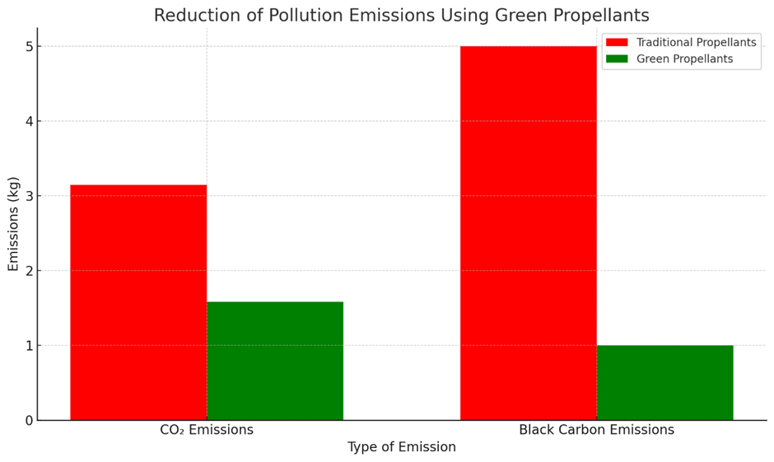
WHY HAN
Composed of hydroxylammonium (NH₂OH) and nitrate (NO₃⁻).
Property / Gas Emission | HAN-Based | Hydrazine
CO (Carbon Monoxide) | <5PPM | 40-50 PPM
NOx (Nitrogen Oxides) | 20-30 PPM | 100-150 PPM
Unburned Hydrocarbons (UHC) | Near 0 | 80 ppm
Greenhouse Gas CO₂ | 20 % less | high
Acute Toxicity LD₅₀ (oral, rat) | > 1000 mg/kg (Low Toxicity) | < 59 mg/kg (High Toxicity)

Slide 14
Feature | Battery-Only Drone | Hybrid Drone (Battery + HAN)
Power Source | Lithium-ion/Li-Po battery | Battery + HAN-based green propellant
Flight Time | 15–25 minutes | 30–40+ minutes
Payload Capacity | Limited (1–2 kg typical) | Higher (2–4 kg or more)
Endurance | Short missions | Longer missions
Energy Efficiency | Decreases with load | Optimized using smart switching between battery & fuel
Thrust Surge Capability | Low (limited to motor output) | High (fuel boost for heavy lift or speed)
Thrust Surge Capability | 10–15 m/s average | 15–25 m/s with burst capability

Slide 15
THANK YOU

